Slide 1
How to Roast Your Own Coffee
At Home - Simply, Deliciously, and Inexpensively Preliminary Design Document for Sweet Maria’s eLearning plan, submitted by Susan Stuart

Slide 3
Design Overview
This document provides a preliminary instructional analysis and eLearning design plan for mastering the coffee roasting process at home. It discusses:
Theoretical foundations ~ Learning theory ~ Learning architecture
Analysis ~ Performance ~ Needs ~ Tasks ~ Target population
Learning objectives + assessment strategies
Training components ~ Content ~ Interactivity ~ Collaborative technologies

Slide 4
Learning Theory Foundation
The learning theories supporting this design are:
Behaviorism
The core of the content is a procedure that needs to be communicated consistently.
Cognitivism
The procedure has variations and dependencies, which require attention, perception, memory, and problem-solving to get right.
Constructivism
Prior knowledge and experiences, as well as social interactions, help learners to create and refine their performance strategies.
The proposed eLearning schema helps customers master the behavior and cognitive cues for optimal outcomes, and supports social learning so customers can construct their own concepts and strategies.

Slide 5
Learning Architecture
Directive (primary)
Highly structured. The main learning content will consist of short learning episodes with brief explanations, examples, and practice with feedback.
Exploratory (optional)
Mainly for higher levels of learning. Customers will have options for exploring deeper information on cupping, precision roasting, coffee growing, brewing and other related topics.

Slide 6
Analysis: Performance + Needs
Can you summarize the performance problem you’ve identified, and your methods for identification?
You have some tutorial content and other documentation on your site. Why do you feel it isn’t enough? What were you looking to accomplish most when you created or selected this material?
Is anyone working on a similar project, or other related documentation?
What would you like to see customers doing differently after this course has launched?
What is the business goal of this request? The expected impact? What would happen if we didn’t do this?
The following are questions to be asked of the core team in regards to desired performance:
Is the training geared more toward attracting or retaining customers?
Do customers usually if know they got their roast exactly right, within an acceptable range, or wrong?
Please discuss the costs to the customer (monetary and morale) and to you when customers don’t get performance right.
How important is it to you to know when customers get performance right or wrong? Do you track that now, and how?
What is the anticipated shelf life of the training?

Slide 7
Analysis: Target Population
The following are questions to be asked of the core team in regards to the target population. (We will propose an additional user research phase, should there be blind spots in knowledge of target learners.):
Who is the target audience? Current customers, potential customers? Anyone else (employees, partners)?
What are their demographics, approximately (age, gender, region, language, level of affluence, education)? Are they foodies, travelers, or do they have other hobbies?
Do they communicate with one another? Are there groups? What value might they find in socializing with one another?
What do you know about their technology usage, in terms of devices, confidence, skill, keeping up with latest, etc.?
What are their main reasons for being interested in your product, as opposed to just buying roasted coffee, where performance isn’t an issue?
How would you describe their confidence and interest when it comes to roasting and coffee in general? Those new at roasting vs. those more experienced.
Please describe any special technical or accessibility needs of learners.
Please describe the geographic distribution of the learners.
What are the key things you believe the learner needs to know to be successful?
What specific behaviors would you like to see that you are not seeing now?
If roasting were being done correctly, what would it look like?
What obstacles prevent current learners from exhibiting the desired behaviors now?

Slide 8
Task Analysis
The basic procedure is as follows. The variations in V.D.2-3 are where the most training effort will be focused.
I. Find and purchase correct model hot-air popper.
II. Alter popper with tin can chimney.
III. Gather equipment in outdoor space in mild weather.
IV. Select beans and determine desired roast.
V. Roast:
A. Warm up popper.
B. Put on oven mitt.
C. Measure beans.
D. Pour in beans.
1) When chaff starts to release (for regular; not decaf), stir occasionally.
2) Watch for color, oils, smoke; listen for cracking.
3) Turn off popper when characteristics of desired roast are observed.
E. Immediately pour beans from popper into metal colanders; toss back and forth to rapid-cool.
F. When beans are completely cool, off-gas for recommended number of hours/ days (if regular; skip for decaf).
G. Store beans.

Slide 9
Learning Objectives
1) Given options for recommended hot-air popcorn poppers and bean varieties, the customer will be able to find and select the best purchases to match their tastes, budget, roasting skills, quantities needed, and interests.
2) Given a bean variety marked with optimal roast ranges, and visual/ aural cues as the bean changes during roasting, a customer will be able to determine an acceptable range of times roasting has finished.
3) Given a sample of regular and decaf bean varieties, and reference data on off-gassing, the customer will be able to name correct cooling and storage techniques per bean variety.
4) Given a bean variety marked with optimal roast ranges, cupping characteristics for those roasts, and visual/ aural cues as the bean changes during roasting, a customer will be able to select a roast that suits their palate, and determine the exact time, within 15 seconds, the roast has been achieved, and the cooling process should begin.

Slide 10
Assessment Techniques
Direct
1) Multiple visual choice quiz matching tastes and budget to bean and popper selection.
2) Drag-and-drop beginner roasting quiz: match aural and visual roasting cues with roast-labeled coffee bean bags; match roasted regular/decaf and regionally labeled beans with alterable time clocks and containers with lids at various positions (sealed, unsealed).
3) Simulation of roast with sounds and bean changes. (The bean variety will match the interests they’ve indicated in completing objective 1.) Learner must choose the precise time the roast finishes (within about a 15-second time range).
Indirect
1) E-mail follow-up from Sweet Maria’s on bean and popper choices, offer of further assistance, and survey.
2) Informal social cupping meetups where folks bring their roasts with bags/ labels. They will grind, brew each others’ roasts, give feedback to each other and receive feedback from experts. Sweet Maria’s will host and provide edible goodies, photographic “tours” of coffee regions visited.
3) “Coffee chat” forum on Sweet Maria’s site where customers can post share tips, ask questions. Promotional tie-ins to encourage participation: 5 posts per month enters you to win free bag.

Slide 11
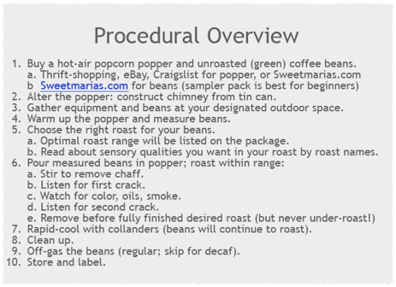
Examples of Content

Slide 12
Examples of Content

Slide 13
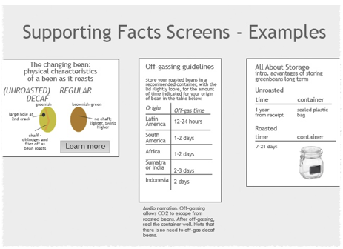
Examples of Content

Slide 14
Interactive Techniques
Sensory reinforcement
In addition to the drag and drop quiz interactivity and simulation assessment, there will be opportunities to review visuals and sounds, and videos of the entire roasting process. These are to help aid in memorization of what an ultimate roast should look and sound like when it’s time to stop roasting and start cooling. For example, a user will be able to mouse over a bag of beans, watch the beans slowly turn the correct color, visibility and oil and smoke, and cycle through cracking sounds. Names of stages of roasts will appear during this cycling.

Slide 15
Social and Mobile Learning
Social media sharing widget (Facebook, Twitter, YouTube) will be available in the online group forums, where the base of the online social learning will take place. Meetup.com can be used to organize in-person meetups, and linked to in the forums.
Mobile app will be developed to use as a sight/ sound aid while roasting.

Slide 16
Thank
you!

